Slide 1
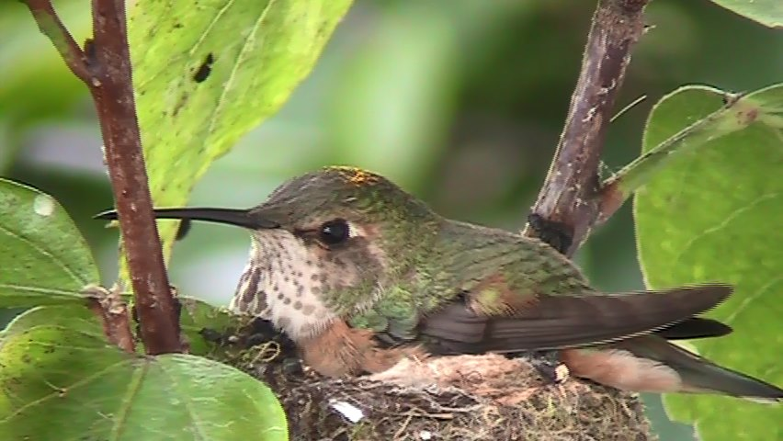
Notes:
Female Anna’s Hummingbird, LMU campus.

Slide 2
Hummingbirds at the Gottlieb Native Garden
Notes:
From foreground to background: Female Anna’s; Male Allen’s; Male Allen’s (photo taken by Maria Curley).

Slide 3
Anna’s Female Hummingbird Nest at Loyola Marymount University
Notes:
2016 LMU – Photo taken by Maria Curley (near dorm closest to UHall bridge)

Slide 4
Notes:
Male Allen’s – near LMU Bluff (Photo taken by Maria Curley).

Slide 5
Notes:
Male Allen’s – near LMU Bluff –(Photo taken by Maria Curley).

Slide 6
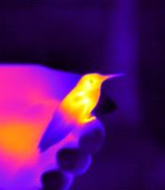
LMU thermal image of hummingbird, taken with Flir Vue Pro R thermal camera, part of an Experiment.com project, “A Mother’s Work is Never Done: Using Thermal Imaging to Detect Torpor in Nesting Hummingbirds”.

Slide 7
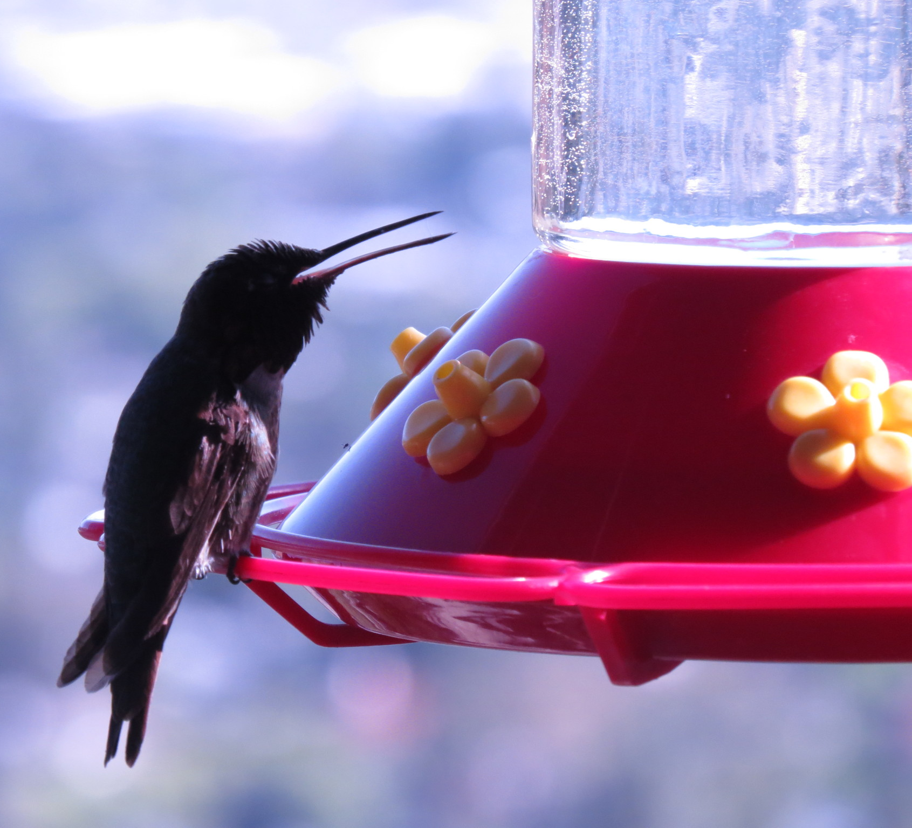
Hummingbird trying to keep cool on a hot summer day in Burbank, CA.
Notes:
Hummingbird at feeder on Jeff & Linnea Milam porch (LMU CURes partners in hummingbird research, Burbank, CA); photo taken by Maria Curley.

Slide 8
Notes:
Male Anna’s hummingbird at LMU feeder (Photo taken by Maria Curley).

Slide 9
Anna’s and Allen’s Hummingbirds at the Gottlieb Native Garden
Notes:
(Photo taken by Maria Curley).

Slide 10
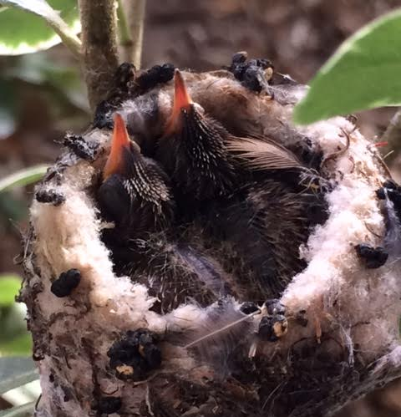
Allen’s Hummingbird Chicks, LMU Nest
Notes:
(Game camera photo).

Slide 11
Notes:
Thermal image of female hummingbird brooding chicks (LMU nest); taken with Flir Vue Pro R.

Slide 12
Notes:
Thermal image of female hummingbird feeding chicks (LMU nest); taken with Flir Vue Pro R.

Slide 13
Notes:
Female Anna’s hummingbird at feeder on LMU campus (photo taken with game camera).

Slide 14
Female Anna’s hummingbird incubating eggs
Notes:
LMU campus.

Slide 15
Notes:
Male Allen’s hummingbird, Playa Vista, CA (Photo by Maria Curley).

Slide 16
Hummingbird Eggs LMU Nest Jan 30, 2018

